Slide 1
Introduction to Operating systems
Single Tasking vs Multi Tasking. Concurrency vs Parallelism

Slide 2
Single-User/Single-Tasking OS
An operating system that allows a single user to perform only one task at a time is called a Single-User Single-Tasking Operating System. Functions like printing a document, downloading images, etc., can be performed only one at a time. Examples include MS-DOS, Palm OS, etc
Advantages
This operating system occupies less space in memory.
Disadvantages
It can perform only a single task at a time.

Slide 3
Single-User/Multitasking OS
An operating system that allows a single user to perform more than one task at a time is called Single-User Multitasking Operating System.
Examples include Microsoft Windows and Macintosh OS.
In a multiprogramming environment, when a process does its I/O, The CPU can start the execution of other processes. Therefore, multiprogramming improves the efficiency of the system.
Advantages
This operating system is more suited to supporting multiple users simultaneously.
The multitasking operating systems have well-defined memory management.
Disadvantages
The multiple processors are busier at the same time to complete any task in a multitasking environment, so the CPU generates more heat.

Slide 4
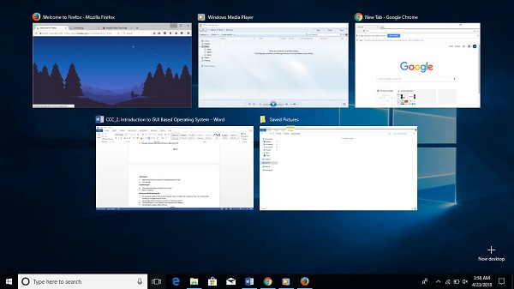
Multitasking OS

Slide 5
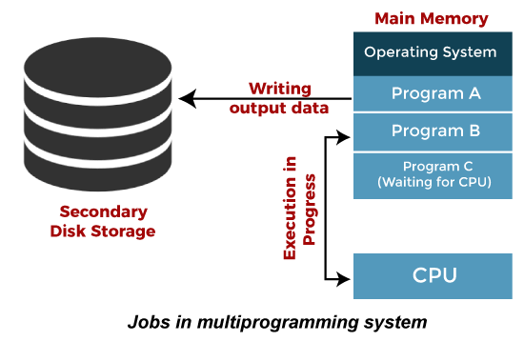

Slide 6
Concurrency vs Parallelism
Concurrency: running multiple threads/processes at the same time, even on a single CPU core, by interleaving their executions
Parallelism: running multiple threads/processes in parallel over different CPU cores

Slide 7
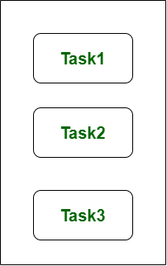
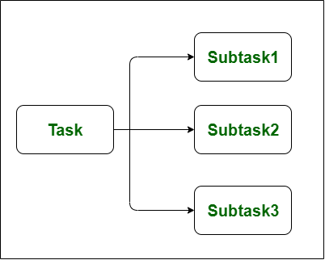
Concurrency Parallelism

Slide 8
